Slide 1
Basics of Program
Brandon Moe

Slide 2
Todays Topics
Introduction to Programming sections
What each section is used for
How to build and run a program
How to build and run a dashboard

Slide 3
Parts of a program

Slide 4
Introduction
Command and control is the process we use to program the robot
It real-time run speed is the fastest that LabVIEW offers
This is a very difficult concept to learn but is worth the benefits it offers

Slide 5
Process
We will be looking at a brand new program and the competition code
I highly recommend that you familiarize yourself with the navigation and know where portions of the code is located.
The pictures included in this presentation are from a close to brand new project.

Slide 6
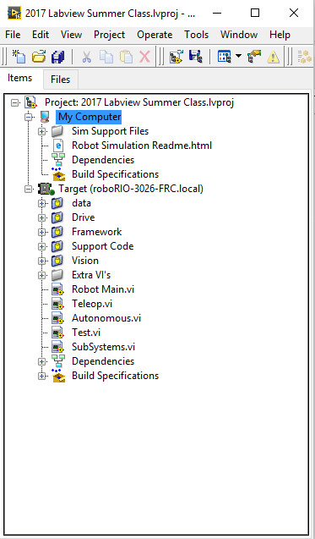
Interface
This is what a new project looks like
Folders are called subsystems

Slide 7

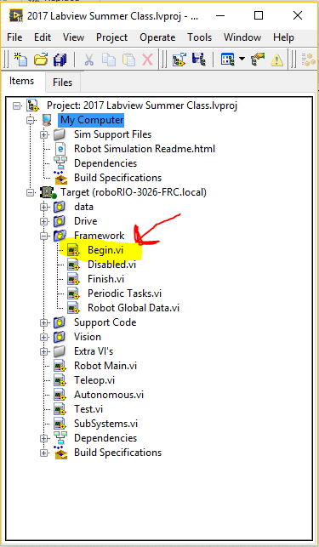
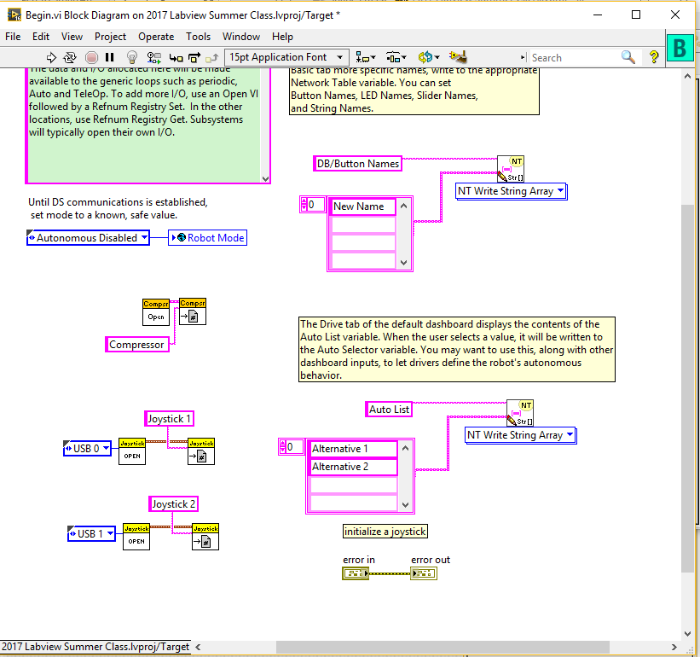
Begin
This is where you will initialize a joystick.
Nothing else should be in here. This includes including motors and solenoids
The only exception is the compressor

Slide 8

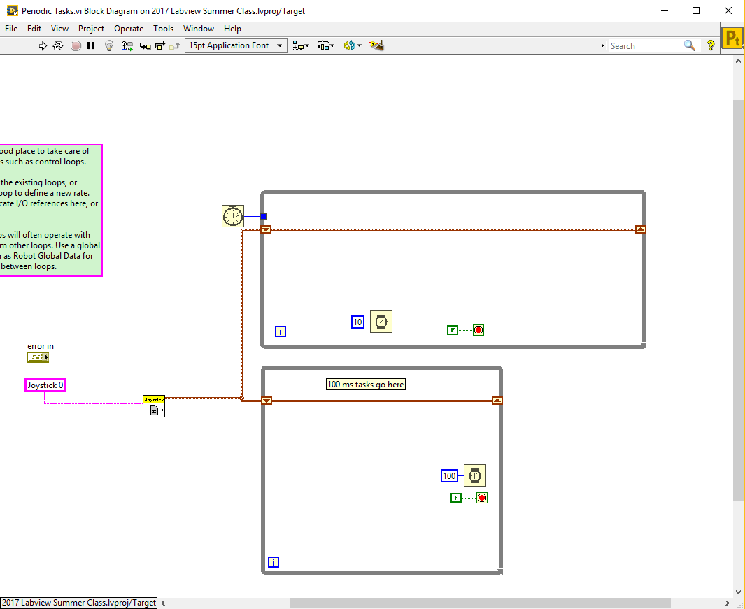
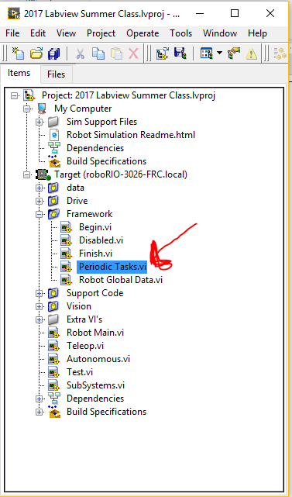
Periodic Tasks
This is where you will put portions of code you want to run all of the time
Ex:
PID
Vision

Slide 9

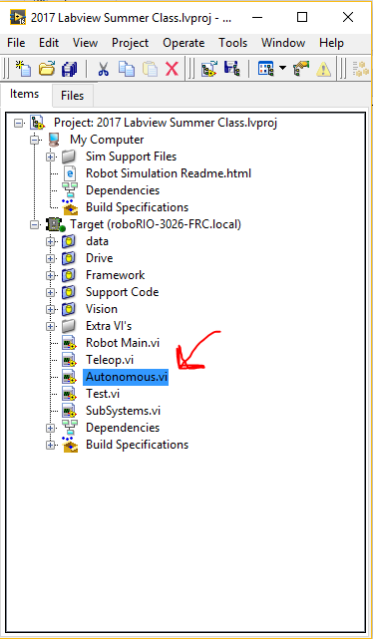
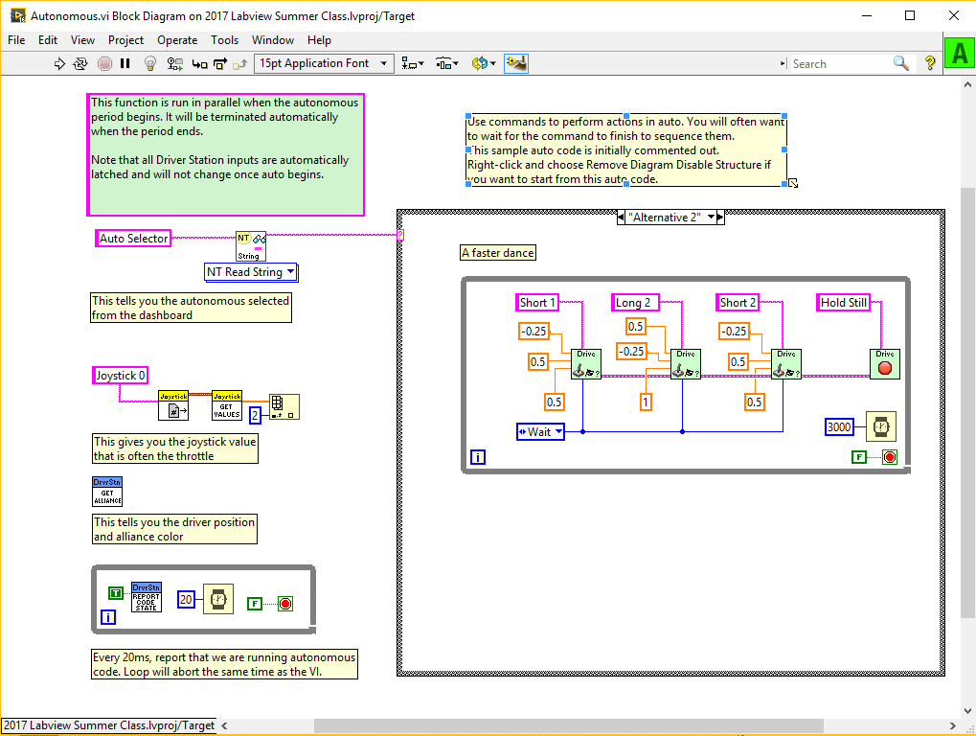
Autonomous
This is where you will program the autonomous section of matches
This will run code without driver input

Slide 10

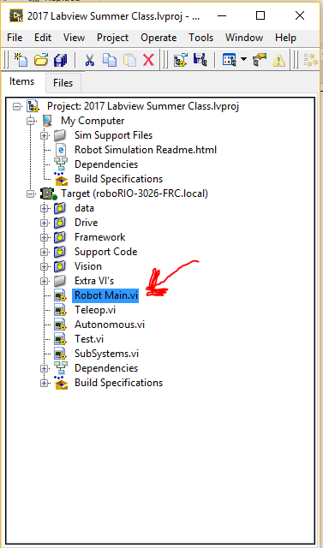
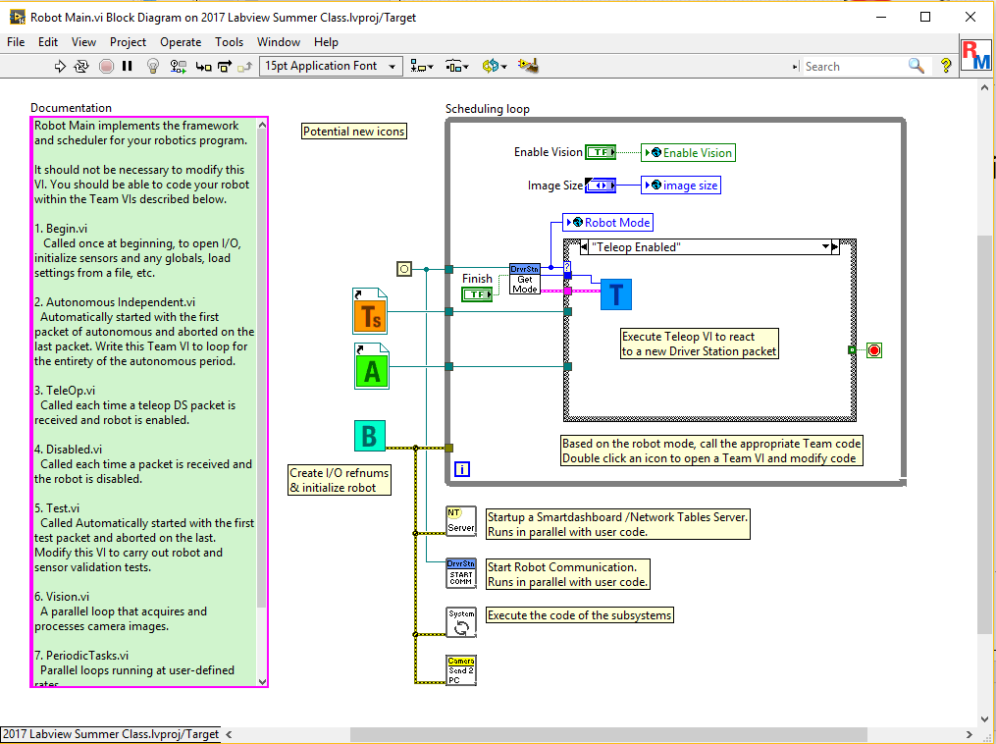
Robot Main
You will not touch this
This is how the robot determines what to run

Slide 11

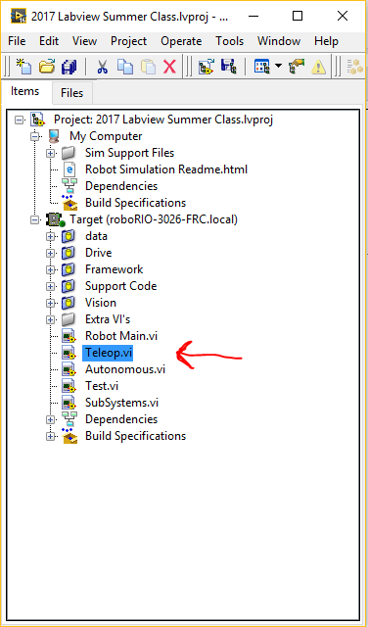
Teleop
This is where you will call of your commands
Joysticks will be processed here

Slide 12
Running Code

Slide 13
Quick deploy
This is used for testing purposes
This will allow you to use controls on the front panel.
Very useful for tuning parts of the robot
PID
Shooter Speed

Slide 14
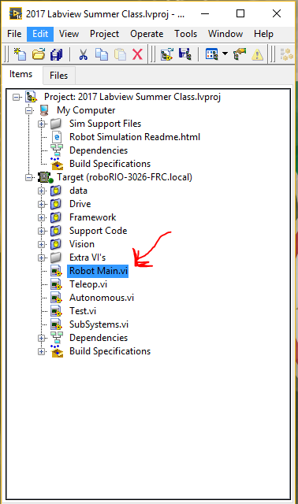
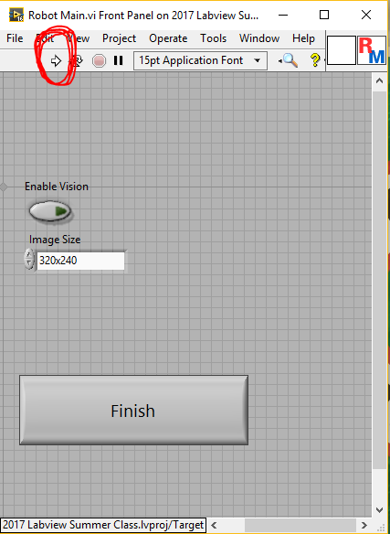
How to quick deploy
Step 1
Step 2

Slide 15
Run as Startup
This is used to put code permintly on the robot
The terminology for this is “Build and Deploy”
When code becomes final or is viable you will do this

Slide 16
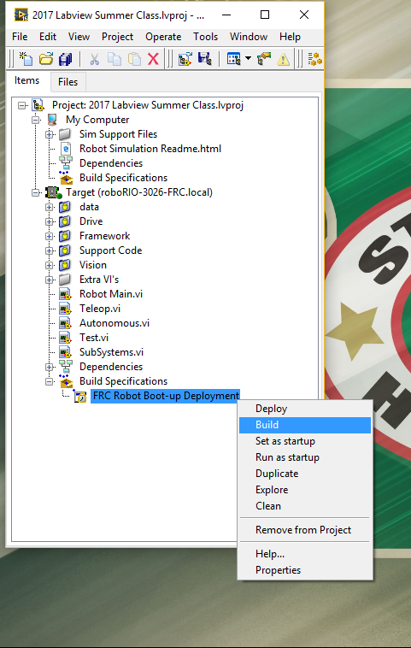
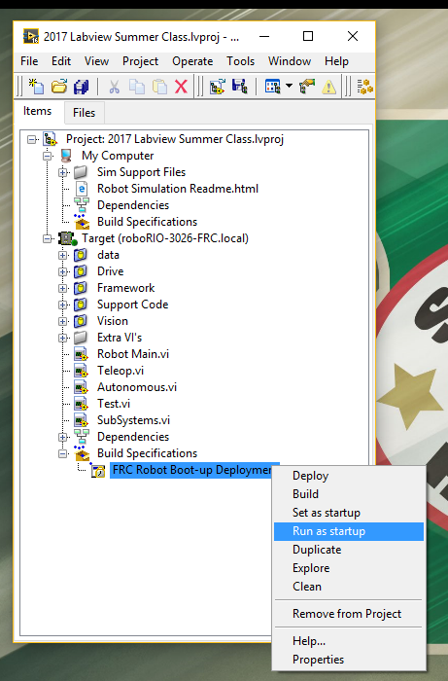
How to Run as Startup
Step 1
Step 2

Slide 17
Build and Run Dashboard

Slide 18
Always build your dashboard
95% of the time you will build a dashboard and not quick deploy it
The build process is slightly different for dashboards

Slide 19
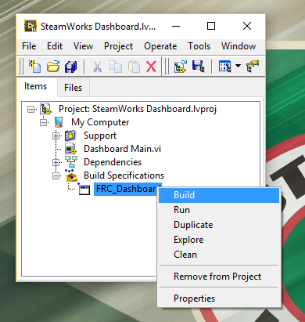
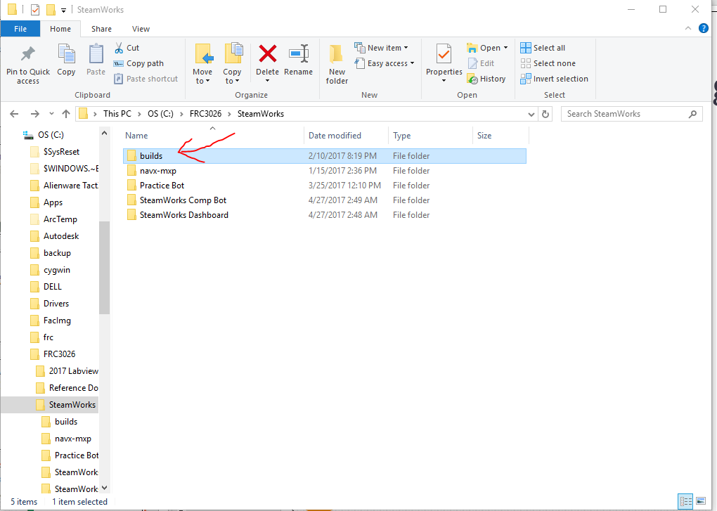
Building and running a dashboard
Step 1
Step 2

Slide 20
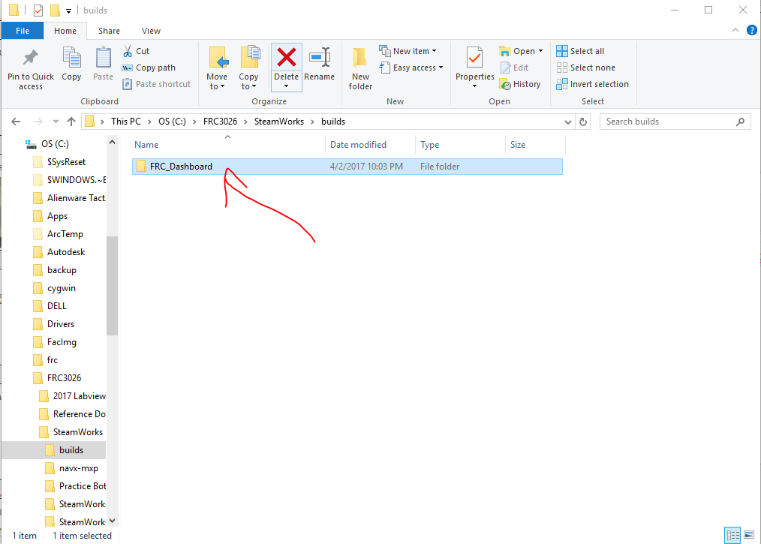
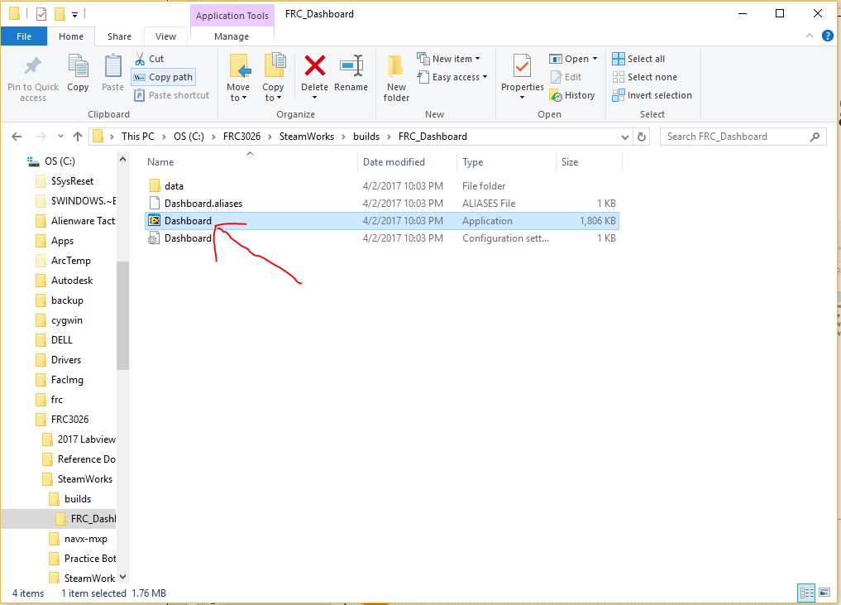
Cont.
Step 3
Step 4

Slide 21
First time running code
When you first run code have the approach of everything doesn’t work until you prove it works
Pu the robot on 2x4 pieces of wood so it will not move
Test all motors and actions
Be ready to hit the space bar to disable it

Slide 22
Project 2
Put The comment “I was Here” in the following places
Begin
Robot Main
Teleop
Periodic Tasks
Autonomous
Build your program
The build file will be located in ..\Builds\home\lvuser\natinst\bin in the programs folder
Upload a print screen of this folder to your source control folder

Slide 23
Turn in Procedure

Slide 24
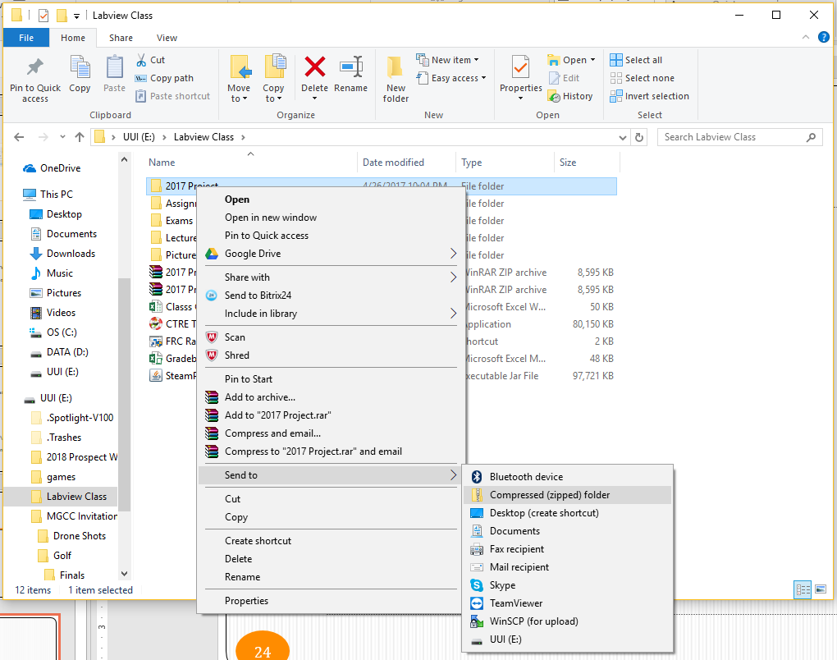
Zip your Project

Slide 25
Email me the ZIP file
moexx399@umn.edu

